Slide 1
Open Licenses and Open Educational Resources:
Why I should care about it?
CC BY-SA 4.0 - Felipe do E. Santo

Slide 2

Attention by Nick Youngson CC BY-SA 3.0 Alpha Stock Images

Slide 3
Who am I?
Professor, Web Developer, and a Mozillian!
2006- Started working with web development;
2014- Joined the Mozilla community and started teaching;
2017 - Became a Mozilla Tech Speaker!
2018 - Started a Master’s in Education
CC BY-SA 4.0 by Felipe Do E. Santo

Slide 4
Education is about sharing
If there's no sharing happening, there's no education happening.
Teachers share their knowledge and skills with students, students share their questions and drafts with teachers.
Those teachers share feedback, criticism, and encouragement with their students. And on it goes.
CC BY-SA 4.0 by Felipe Do E. Santo

Slide 5
Open Education
Since 2006 Open Education gained a lot of strength in various sectors of society as internet and digital technology advances.
Open Education seeks to promote the freedom to use, change, combine, and redistribute educational resources from the use of open technologies. The concept also involves principles related to open pedagogical practices.
CC BY-SA 4.0 by Felipe Do E. Santo

Slide 6
Open Education
The Open Education movement involves the search for alternatives to some of the obvious barriers to the right to quality education and is aligned with the 4th United Nations Sustainable Development Goal.
CC BY-SA 4.0 by Felipe Do E. Santo

Slide 7

By Jonathasmello - Own work, CC BY 3.0, https://commons.wikimedia.org/w/index.php?curid=18460156

Slide 8
Open Educational Resources (OER)
The foundation of Open Education is Open Educational Resources (OER), which are teaching, learning, and research resources that are free of cost and access barriers, and which also carry legal permission for open use.
CC BY-SA 4.0 by Felipe Do E. Santo

Slide 9
Open Educational Resources (OER)
The OER can be books, book chapters, lesson plans, software, games, reviews, school work, articles, manuals, videos, audios, and images, among other types.
The main idea of OER is that any learning resource that a person publishes can be used and recombined by other people in different ways as a way of expanding knowledge.
CC BY-SA 4.0 by Felipe Do E. Santo

Slide 10
Open License
Generally, the permission is granted by use of an open license (for example, Creative Commons licenses) which allows anyone to freely use, adapt, and share the resource—anytime, anywhere.
“Open” permissions are typically defined in terms of the “5R’s” (it’s common to see references to 4R’s also)
CC BY-SA 4.0 by Felipe Do E. Santo

Slide 11
5R activities
1 - Retain - the right to make, own, and control copies of the content (e.g., download, duplicate, store, and manage)
2 - Reuse - the right to use the content in a wide range of ways (e.g., in a class, in a study group, on a website, in a video)
CC BY-SA 4.0 by Felipe Do E. Santo
Notes:
Probably you already saw something similar right? It’s really similar to the four freedoms.

Slide 12
5R activities
3 - Revise - the right to adapt, adjust, modify, or alter the content itself (e.g., translate the content into another language)
4 - Remix - the right to combine the original or revised content with other material to create something new (e.g., incorporate the content into a mashup)
CC BY-SA 4.0 by Felipe Do E. Santo
Notes:
Probably you already saw something similar right? It’s really similar to the four freedoms.

Slide 13
5R activities
5 - Redistribute - the right to share copies of the original content, your revisions, or your remixes with others (e.g., give a copy of the content to a friend)
CC BY-SA 4.0 by Felipe Do E. Santo
Notes:
Probably you already saw something similar right? It’s really similar to the four freedoms.

Slide 14
How can I have my material under the 5 R's?
CC BY-SA 4.0 by Felipe Do E. Santo

Slide 15

When we share, everyone wins
Notes:
To achieve this openness with our material we can share our content under a open license like Creative Commons.

Slide 16
Creative Commons
Creative Commons is a non-profit organization that allows the sharing and use of creativity and knowledge through free legal instruments.
Creative Commons licenses are not contrary to copyright. They work in addition to copyright and allow you to modify your copyright terms to best suit your needs.
CC BY 4.0 by Felipe

Slide 17
Poor Technical Choices
Make Open Content Less Open
CC BY-SA 4.0 by Felipe Do E. Santo
Notes:
And how we can check that?

Slide 18
ALMS Analysis / Framework
David Wiley (2009) developed the ALMS Analysis as a framework for thinking about these technical aspects of localization.
ALMS is an acronym that stands for:
Access to editing tools? Level of expertise required to revise or remix? Meaningfully editable? Source-file access?
CC BY-SA 4.0 by Felipe Do E. Santo

Slide 19
Access to Editing Tools
Is the open content published in a format that can only be revised or remixed using tools that are extremely expensive?
Is the open content published in an exotic format that can only be revised or remixed using tools that run on an obscure or discontinued platform?
CC BY-SA 4.0 by Felipe Do E. Santo

Slide 20
Access to Editing Tools
Also, Is the open content published in a format that can be revised or remixed using tools that are freely available and run on all major platforms?
CC BY-SA 4.0 by Felipe Do E. Santo

Slide 21
Level of Expertise Required
Is the open content published in a format that requires a significant amount technical expertise to revise or remix?
Is the open content published in a format that requires a minimum level of technical expertise to revise or remix?
CC BY-SA 4.0 by Felipe Do E. Santo

Slide 22
Meaningfully Editable
Is the open content published in a manner that makes its content essentially impossible to revise or remix (e.g., a scanned image of a handwritten document)?
Is the open content published in a manner making its content easy to revise or remix (e.g., a text file)?
CC BY-SA 4.0 by Felipe Do E. Santo

Slide 23
Self-Sourced
It the format preferred for consuming the open content the same format preferred for revising or remixing the open content (e.g., HTML)?
Is the format preferred for consuming the open content different from the format preferred for revising or remixing the open content (e.g. Flash FLA vs SWF)?
CC BY-SA 4.0 by Felipe Do E. Santo

Slide 24
What do undergraduate students (future teachers) know about Open Licenses / OER?
CC BY-SA 4.0 by Felipe Do E. Santo
Notes:
This is the main question of my research, I want to better understand what those future teachers think about Open Licenses and OER

Slide 25
Survey with future teachers
In the first half of this year I started my research with future teachers, we did some activities during the semester, and I collected some information about them and about what they know about open licenses and OER.
Regarding the characterization of the participants, they are between 20 and 24 years old, in the majority, 17 students (81%) attending the first degree. Only 9 (42.9%) of the individuals do not have any kind of experience as teachers.
CC BY-SA 4.0 by Felipe Do E. Santo

Slide 26
Survey - Technological profile
The participants’ technological profile provided essential data for the understanding of subjects’ experiences with technology. 15 individuals (71.4%) use the computer 1 or more times a day, 5 (23.8%) use 3 or more times in the week, 1 (4.8%) use less than 3 times a week and the option “Rarely” was not selected by any of the participants.
Complementing this question, 18 participants (90%) stated that every time they use the computer, they also use the Internet.
CC BY-SA 4.0 by Felipe Do E. Santo

Slide 27
Survey - What they know about licenses?
In relation to the verification of the licenses of content found on the web, which often indicate the restriction of use of this content, 12 (57.1%) of the participants reported not having knowledge about the ways of consulting the license, 4 (19 %) answered that they did not carry out the consultation.
Only 5 (23.8%) stated that they always verify the license of the published material.
CC BY-SA 4.0 by Felipe Do E. Santo

Slide 28
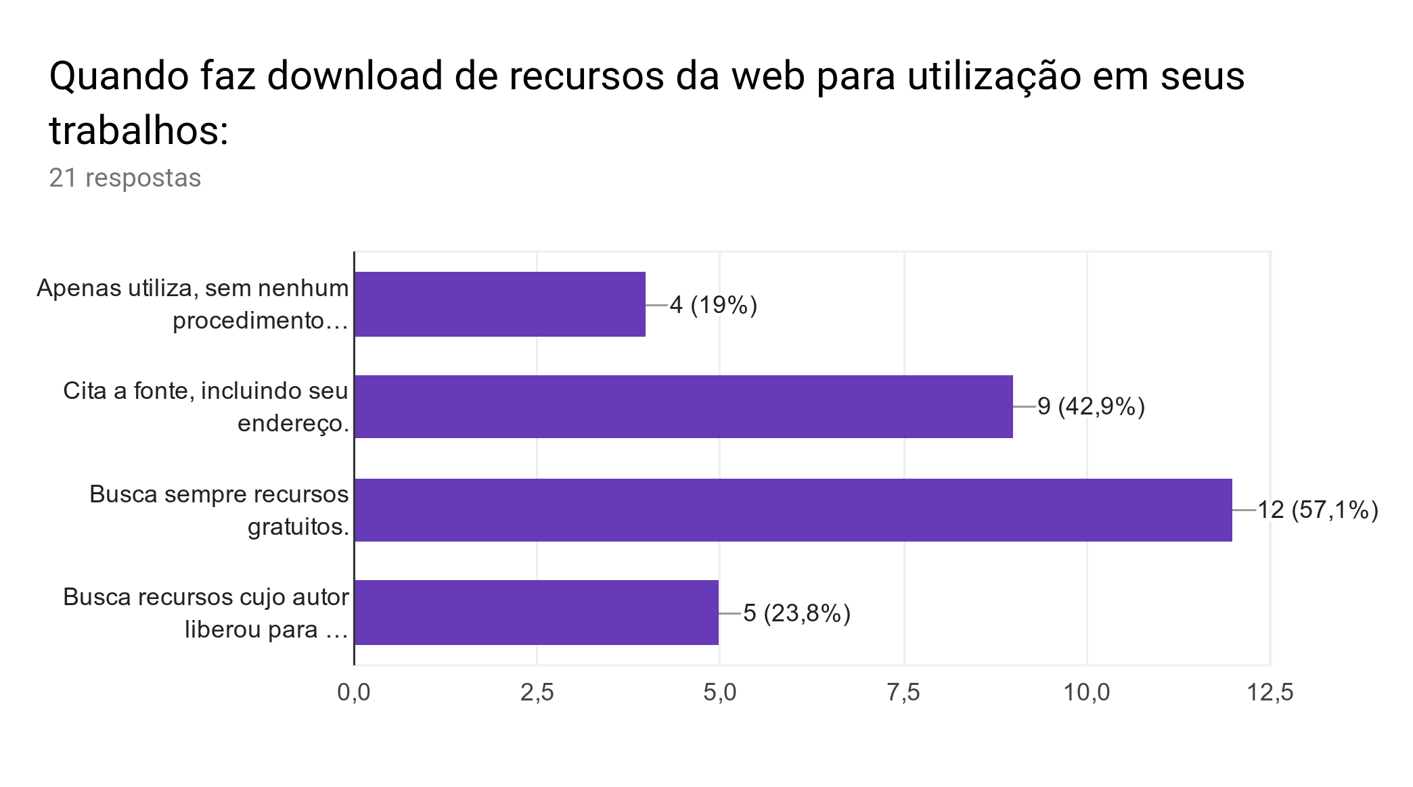
Survey - What they know about licenses?
CC BY-SA 4.0 by Felipe Do E. Santo

Slide 29
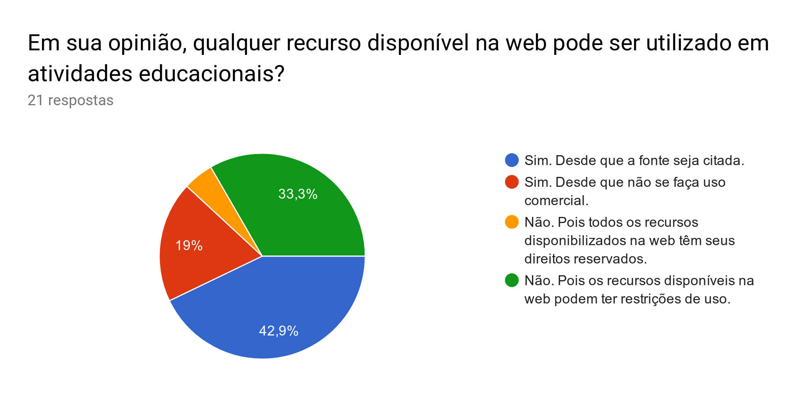
Survey - What they know about licenses?
CC BY-SA 4.0 by Felipe Do E. Santo

Slide 30
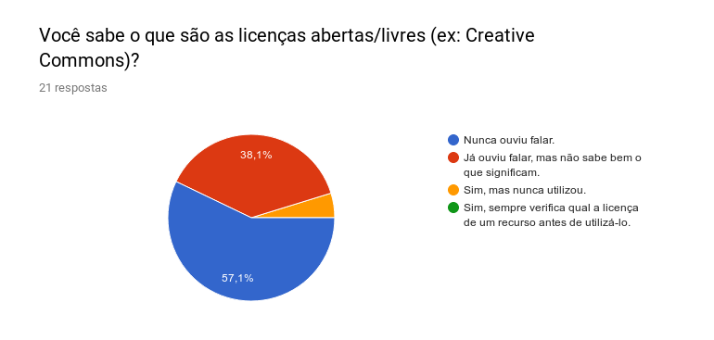
Survey - What they know about licenses?
CC BY-SA 4.0 by Felipe Do E. Santo

Slide 31
Survey - conclusion and actions
We infer from the data that most participants are not aware of the rules and conditions that are inherent in OER. They consider that, because it is published on the Internet, there are no rules. This confirms the importance of promoting specific training on the subject.
We developed with those students two activities, right now, we are analyzing the data to see the results and what can be improved in future interventions.
CC BY-SA 4.0 by Felipe Do E. Santo
Notes:
We want to check with this research the impacts of this formation on those future teachers.

Slide 32
In a nutshell
The lack of knowledge pointed out by the participants in the available license formats and in the rules that must be respected when using an OER demonstrates the importance of preparation for teachers in which studies and activities on OERs are developed.
A preparation capable of encouraging the publication of content freely and openly, thus ensuring freedom for reuse and remixing of the materials produced.
CC BY-SA 4.0 by Felipe Do E. Santo

Slide 33
In a nutshell
Openness is impacting many areas of education—teaching, curriculum, textbooks, research, policy, and others. How will these individual impacts synergize to transform education?
CC BY-SA 4.0 by Felipe Do E. Santo

Slide 34
Stay connected
@felipez3r0 on GitHub, Twitter
felipe@2ilabs.com.br
CC BY-SA 4.0 by Felipe Do E. Santo
Notes:
If you want to know more about my projects, what I’m doing, where you can find me, and all this stuff: follow me on Twitter and Github.
And if you want to chat about something you have my email too.

Slide 35
Questions?
CC BY-SA 4.0 by Felipe Do E. Santo
Notes:
Thanks for your time, and if you have any questions I’m here to help!

Slide 36
Thank you! 😃
CC BY-SA 4.0 by Felipe Do E. Santo

Slide 37

License
This work is licensed under a Creative Commons Attribution-ShareAlike 4.0 International License.
https://creativecommons.org/licenses/by-sa/4.0/
CC BY-SA 4.0 by Felipe Do E. Santo

